Slide 1
USDA NRCS Overview
Feb 7, 2024
Breana Garcia
NRCS Soil Conservationist &
Women’s Special Emphasis Program Manager

Slide 2
Intro
Breana Garcia
Soil Conservationist and Women’s Special Emphasis Program Manager for the USDA NRCS
Working in the Central Valley, Kern County
Bakersfield, California

Slide 3
NRCS INTRODUCTION
The U.S Department of Agriculture’s Natural Resources Conservation Service (NRCS) is the primary Federal agency that works with private landowners to help them protect their natural resources.
We address the following resource concerns: Soil, Water, Air, Plants, Animals, Energy, Human (Economic/Social)

Slide 4
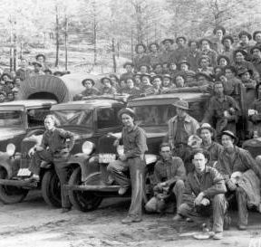
NRCS HISTORY
NRCS was established in troubled times--the Dust Bowl days of the 1930s. Dust storms ravaged the Nation’s farmland, stripping away millions of tons of topsoil.
Notes:
On April 27, 1935 Congress passed Public Law 74-46, in which it recognized that "the wastage of soil and moisture resources on farm, grazing, and forest lands . . . is a menace to the national welfare," and it directed the Secretary of Agriculture to establish the Soil Conservation Service (SCS) as a permanent agency in the USDA. In 1994, Congress changed SCS’s name to the Natural Resources Conservation Service (NRCS) to better reflect the broadened scope of the agency’s concerns.

Slide 5
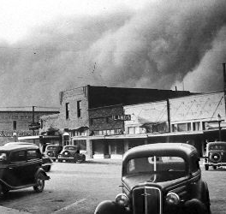
NRCS HISTORY
Huge dust clouds carried the soil hundreds of miles, all the way to the Atlantic Ocean.
Notes:
In May 1934, the first great dust storm in the Great Plains swept soil particles over Washington, DC, and 300 miles further east into the Atlantic Ocean.
The second dust storm hit in March 1935 in Kansas, Colorado, Texas, and Oklahoma, and again swept soil particles across Washington, DC, and other eastern cities.

Slide 6
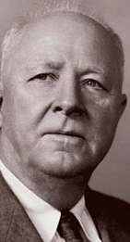
NRCS HISTORY
Soil erosion concerns brought to light by Hugh Hammond Bennett during the Dust Bowl era.
Passed by U.S. Congress during the 1st term of President Franklin D. Roosevelt, the New Deal included funds to fight soil erosion (Soil Conservation and Domestic Allotment Act of 1936).
September 19, 1933 - Soil Erosion Service (SES) established.
1994 – SCS renamed Natural Resources Conservation Service (NRCS) following expansion of the agency’s scope.
Notes:
Congress understood the impacts of the deterioration of our natural resources and took action and formed the agency which continues it’s proud heritage of working with Farmers and Ranchers in the US, and US territories.

Slide 7
NRCS MISSION
NRCS works with private landowners to develop conservation plans that consider the needs of the landscape and the objectives of the customer.
Our mission is to provide resources to farmers and landowners to aid them with conservation.

Slide 8
TECHNICAL & FINANCIAL ASSISTANCE
Contact NRCS Office
Submit an Application/Request for Assistance
NRCS employee will make a site visit
They will inform you of what assistance is available in your area and applicable for your land
Agency programs are completely Voluntary, non-regulatory, and focused on private lands.
Notes:
Our mission is to provide resources to farmers and landowners to aid them with conservation. We can do that through technical assistance which entails: giving information about soils, making recommendations for cover crops, and general conservation advice. More often though, we are sought out for financial assistance.
Resource concerns and benchmark conditions are assessed at a site visit.
We take applications year round but rank during specific times.
The more concerns addressed rank higher and are more likely to get funding. So it is a ranking process where funding is not guaranteed.
Examples of practices available in my area: Irrigation- flood to drip, tractors,

Slide 9
https://www.nrcs.usda.gov/programs-initiatives
Notes:
Scroll through website – programs offered may not be applicable to all areas. The most common program used is EQIP

Slide 10
https://www.nrcs.usda.gov/about/priorities/inflation-reduction-act
Notes:
https://www.nrcs.usda.gov/about/priorities/inflation-reduction-act

Slide 11
https://www.nrcs.usda.gov/ranking-dates
Notes:
Website shows ranking deadlines per state. Take applications all year but rankings only when delegated. Trying to do once a year. Not sure what will happen now.

Slide 12
https://www.nrcs.usda.gov/conservation-basics/conservation-by-state

Slide 13
SIGN UP TO STAY INFORMED
https://www.nrcs.usda.gov/programs-initiatives

Slide 14
CONTACT YOUR LOCAL SERVICE CENTER
https://www.nrcs.usda.gov/contact

